Slide 1


BEVERAGE SALES ANALYSIS
Analyzing beverage sales data and developing an interactive dashboard to visualize key business insights. The dashboard highlights the following:
Total sales performance by month
Sales contribution by beverage brand
Retailer-wise sales breakdown
Sales distribution across states and cities
Key metrics including total sales, units sold, operating profit, and operating margin

Slide 2
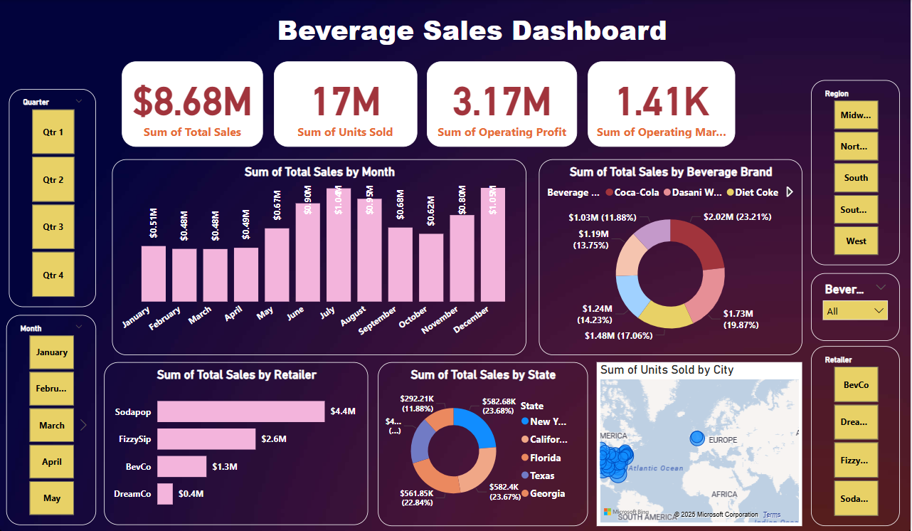

Slide 3

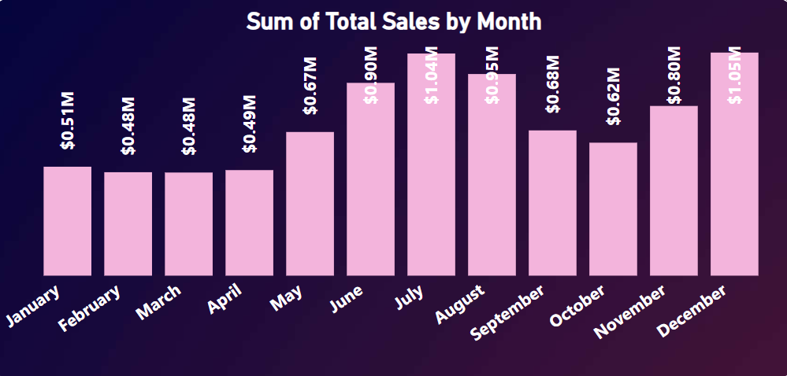
Sum of Total Sales by Month
This chart represents the month-wise sales trend of beverages across the year. According to the analysis, sales peaked during the summer months, indicating higher consumer demand during warmer seasons. A noticeable dip in early spring suggests seasonal variation in beverage consumption. This trend helps in forecasting future demand and planning marketing efforts accordingly.

Slide 4
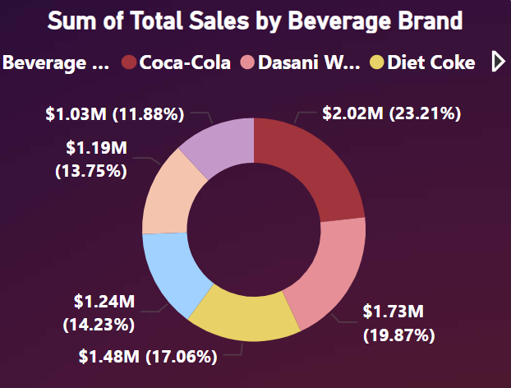
Sum of Total Sales by Beverage Brand
This donut chart illustrates the total sales distribution among different beverage brands. According to the analysis, Coca-Cola emerges as the leading brand, followed by Diet Coke and Dasani Water. These three brands together contribute a significant portion of the overall sales, indicating strong consumer preference. This insight is valuable for making brand-level strategic decisions.

Slide 5
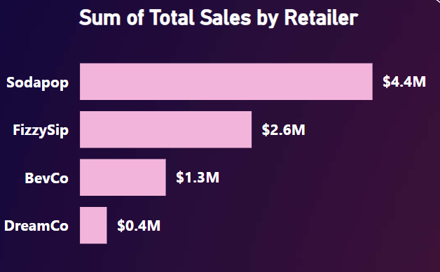
Sum of Total Sales by Retailer
This graph compares the total sales generated by various retail partners. The analysis shows that Sodapop is the highest contributing retailer, followed by FizzySip and BevCo. This distribution reflects the effectiveness of retailer partnerships and their market outreach. Such insights are crucial for optimizing supply chains and strengthening retail collaborations.

Slide 6
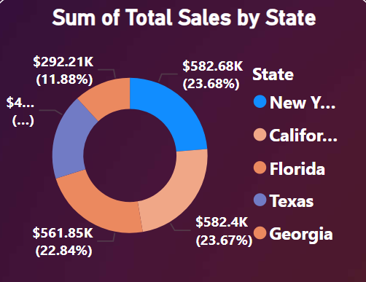
Sum of Total Sales by state
The donut chart illustrates the total sales distribution across five U.S. states. New York has the highest sales at $582.68K (23.68%), followed very closely by California with $582.4K (23.67%). Florida contributes $561.85K (22.84%) to the total, while Texas records $292.21K (11.88%). Georgia's value is partially hidden but represents the remaining percentage. The chart highlights that New York, California, and Florida are the top contributors in terms of sales.

Slide 7
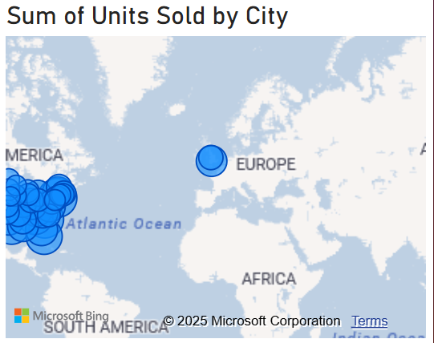
Sum of Units Sold by City
The map chart represents the sum of units sold by city, visualized using blue circles. The size of each circle indicates the volume of units sold in that city. Major concentrations of sales activity are visible in the United States and parts of Europe, suggesting these regions have the highest number of units sold.

Slide 8

Thank You
For Watching

